Slide 1
Labels
You can put labels , titles , and text on a plot by using the
commands :
Xlabels('text')
ylabels('text')
zlabels('text')
title('text')
text(x, y, 'text') places text at position x ,y
gtext('text') use mouse to place text

Slide 2
to put mathematics in labels you can use Matlab's backslash notation.

Slide 3
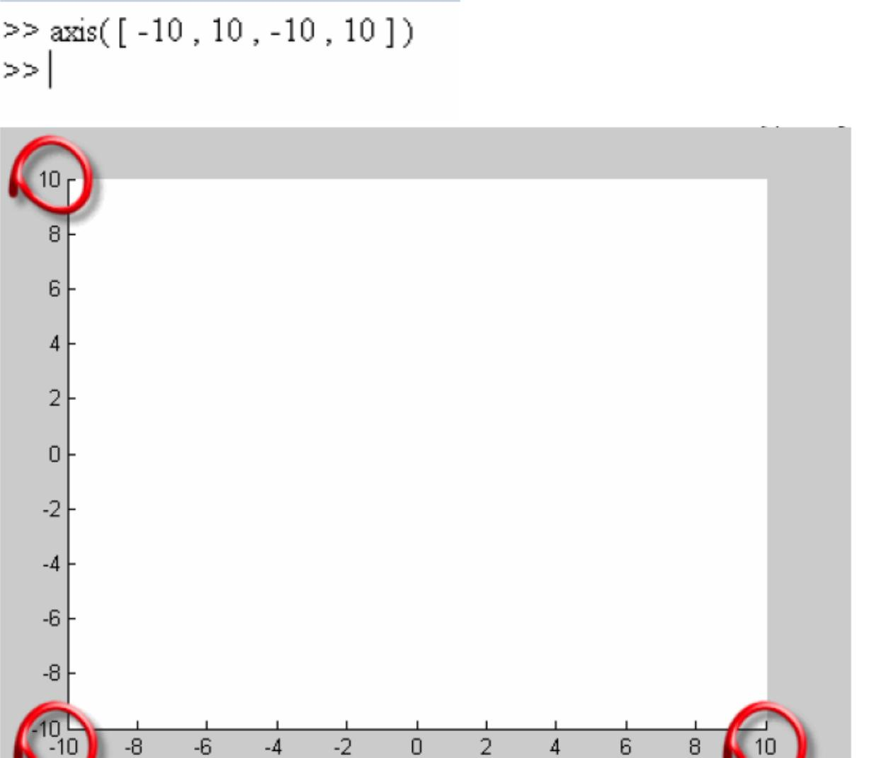
Axes
So far we have allowed matlab to choose the axes for our plots , you can change the axes in many ways:
Axis ([xmin xmax ymin ymax]) set the axes' minimum and maximum values.
Example:

Slide 4
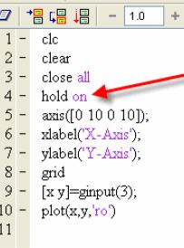
We can enter any number of points by mouse as following
By using getinput command

